Slide 1

Poornima Institute of Engineering & Technology
PROJECT TITLE
TEAM NAME: A3
PROJECT ID: 8CS PR 2018_19_01
STUDENTS NAME:
1. Abhinav Sharma
2. Aditya Ranga
3. Aman Solanki
Project Guide By: Dr. Praveen Gupta Department of Computer Engineering PIET , Jaipur

Slide 2
Vision of Department
Department of computer engineering shall create an environment in which new ideas, research and technology grows and form which technocrats and innovators of tomorrow come forward to face the global challenges. It aims at being recognized globally as role model and be a part of substantial natural resources.

Slide 3
Mission of Department
To develop competent professional with innovative mind set, problem solving, design and implementation skills through excellent under graduate education.
To provide platform to students so that they can expertise themselves as a computer professional, entrepreneurs or as a manager while fulfilling their ethical and social responsibility in a globally competitive environment.
To contribute significantly to the research and discovery of new arenas of methods and knowledge in the field of computer engineering.

Slide 4
Index
Objectives
Introduction
Product Backlog
Sprint Backlog-1
Sprint Backlog-II
Sprint Backlog-III
Sprint Backlog-IV
Project Screen-shots.
Results
Conclusion and Future Scope

Slide 5
Objective
The aim of the project is to develop an online website with the help of which a user can create his/her resume without a hassle.
Resume plays an important role in grabbing the perfect job or the dream job and if you have worked so hard in your life for this one chance you need to be fully prepared and the first thing that will help you get that job is a resume and the user can create one with the help of our website
Resume attracts the Interviewer most it’s like first impression of the candidate and the candidate can create that with a perfect resume as resume contains all the information he has done from the time of born to now.
It contain what are the skills that the candidate possess whether it’s a soft skill or a technical skill.
Resume gives a brief idea about one’s personality and it will also an help for the interviewer to judge whether the candidate is suitable for their job or not.

Slide 6
Introduction
For job hiring, the resume is the most important thing in any of the company interviews to get the job in that company. Resume has to be so impressive so that the first impression of a student will be nice on the interviewer because the first impression can be enough in any interview. So, Resume Builder becomes the most helpful platform for any student to make a resume effectively and impressively.

Slide 7
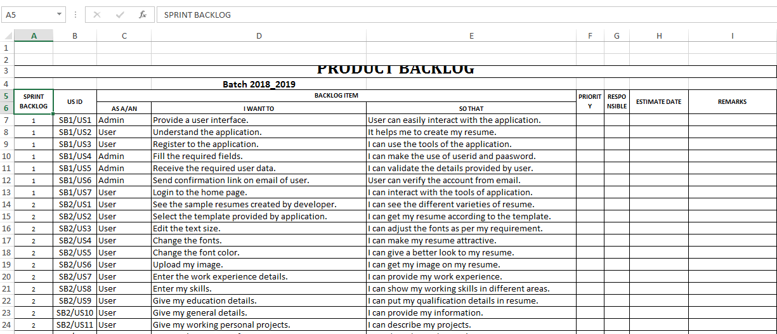
Product Backlog

Slide 8
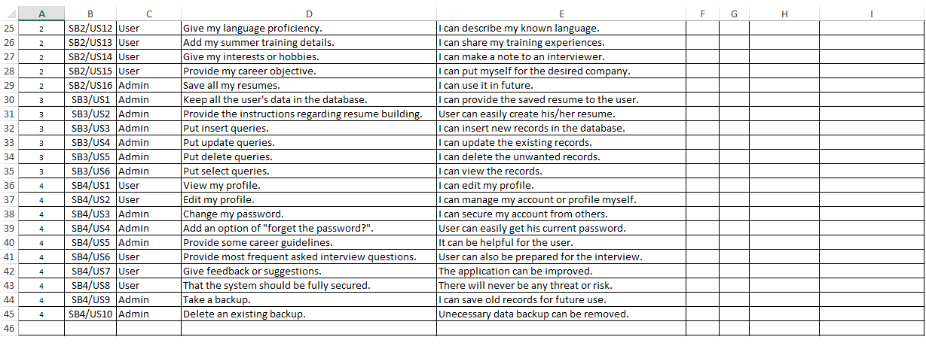
Product Backlog

Slide 9
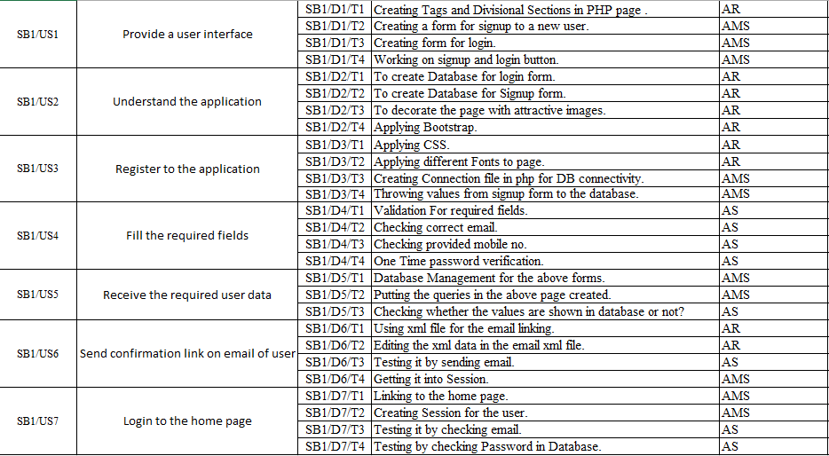
Sprint Backlog -1

Slide 10
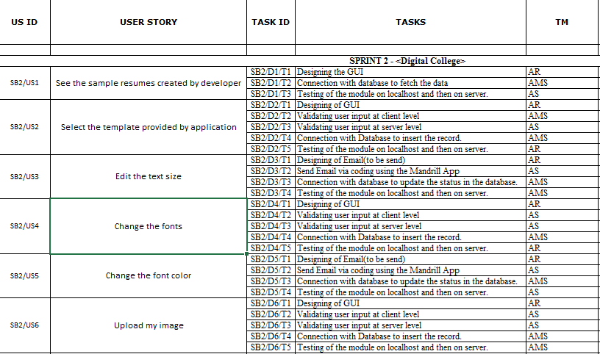
Sprint Backlog -2

Slide 11
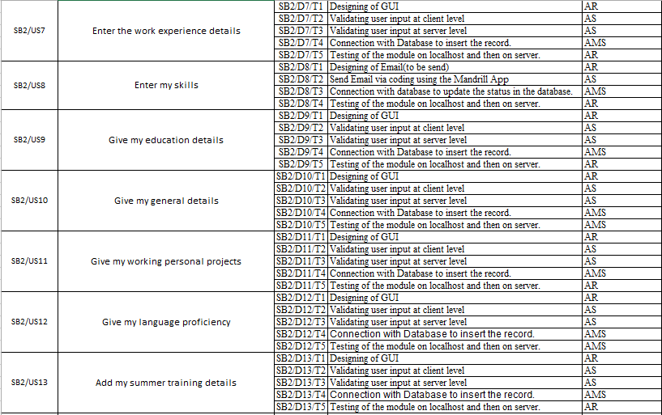
Sprint Backlog -2

Slide 12
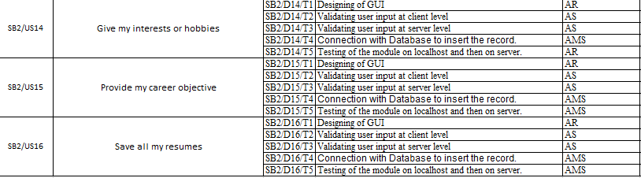
Sprint Backlog -2

Slide 13
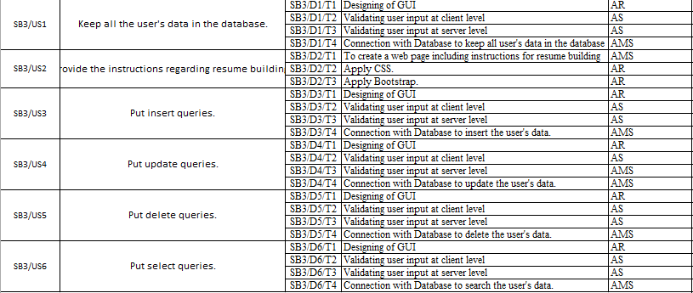
Sprint Backlog -3

Slide 14
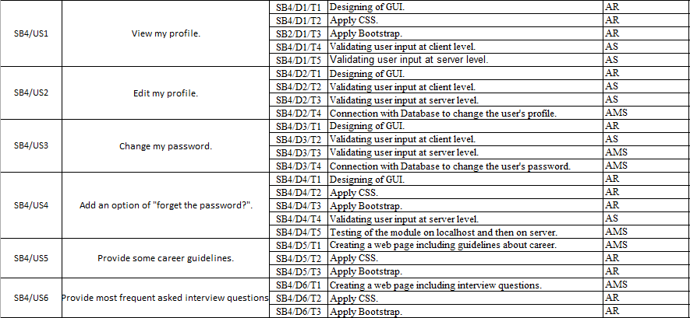
Sprint Backlog -4

Slide 15
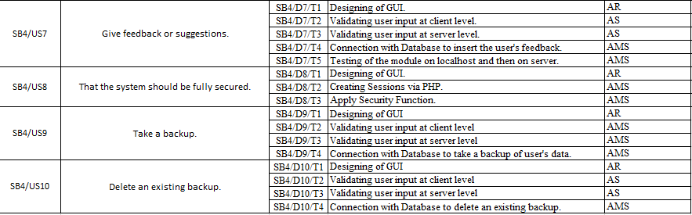
Sprint Backlog -4

Slide 16
Project Screen-shots:

Slide 17
Project Screen-shots:

Slide 18
Project Screen-shots:

Slide 19
Project Screen-shots:

Slide 20
Project Screen-shots:

Slide 21
Results
The user is able to make his resume successfully.
The user can make his resume from various templates.

Slide 22
Conclusion and Future Scope

Slide 23

Thanks

